Slide 1
Embedded Zerotree Wavelet
- An Image Coding Algorithm
Shufang Wu
http://www.sfu.ca/~vswu
vswu@cs.sfu.ca
Friday, June 14, 2002

Slide 2
Agenda
Overview
Discrete Wavelet Transform
Zerotree Coding of Wavelet Coefficients
Successive-Approximation Quantization (SAQ)
Adaptive Arithmetic Coding
Relationship to Other Coding Algorithms
A Simple Example
Experimental Results
Conclusion
References
Q & A

Slide 3
Overview (2-1)
Two-fold problem
  Obtaining best image quality for a given bit rate
  Accomplishing this task in an embedded fashion
What is Embedded Zerotree Wavelet (EZW) ?
  An embedded coding algorithm
  2 properties, 4 features and 2 advantages (next page)
What is Embedded Coding?
  Representing a sequence of binary decisions that distinguish an image from the “null” image
  Similar in spirit to binary finite-precision representations of real number

Slide 4
Overview (2-2)
- Embedded Zerotree Wavelet (EZW)
2 Properties
  Producing a fully embedded bit stream
  Providing competitive compression performance
4 Features
  Discrete wavelet transform
  Zerotree coding of wavelet coefficients
  Successive-approximation quantization (SAQ)
  Adaptive arithmetic coding
2 Advantages
  Precise rate control
  No training of any kind required

Slide 5
Agenda
Overview
Discrete Wavelet Transform
Zerotree Coding of Wavelet Coefficients
Successive-Approximation Quantization (SAQ)
Adaptive Arithmetic Coding
Relationship to Other Coding Algorithms
A Simple Example
Experimental Results
Conclusion
References
Q & A

Slide 6
Discrete Wavelet Transform (2-1)
Identical to a hierarchical subband system
  Subbands are logarithmically spaced in frequency
  Subbands arise from separable application of filters
LL2
HL2
LL1
HL1
HL1
LH2
HH2
LH1
HH1
LH1
HH1
First stage
Second stage

Slide 7
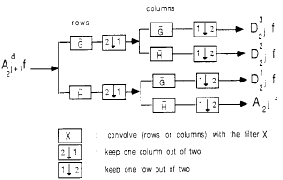
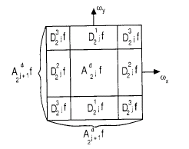
Discrete Wavelet Transform (2-2)
Wavelet decomposition (filters used based on 9-tap symmetric quadrature mirror filters (QMF))
w_{y}
Df1
Df1
D³₂^{j}f
w_{x}
In the frequency domain
Image wavelet representations

Slide 8
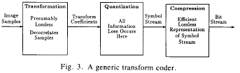
Zerotree Coding (3-1)
A typical low-bit rate image coder
  Large bit budget spent on encoding the significance map
Binary decision as to:
whether a coefficient has a zero or nonzero quantized value
True cost of encoding the actual symbols:
Total Cost = Cost of Significance Map
+ Cost of Nonzero Values

Slide 9
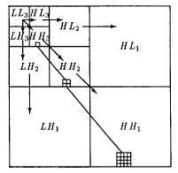
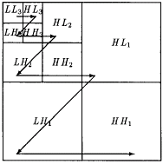
Zerotree Coding (3-2)
What is zerotree?
  A new data structure
  To improve the compression of significance maps of wavelet coefficients
Parent:
The coefficient at the coarse scale.
Child:
All coefficients corresponding to the same spatial location at the next finer scale of similar orientation.
IF:
A wavelet coefficient at a coarse scale is insignificant with respect to a given threshold T,
THEN:
All wavelet coefficients of the same orientation in the same spatial location at finer scales are likely to be insignificant with respect to T.
Scanning rule:
No child node is scanned before its parent.
a wavelet coefficient x is said to be insignificant with respect to a given threshold T if :
|x| < T
What is insignificant?
A coefficient x is
IF
itself and all of its descendents are insignificant with respect to T.
Zerotree is based on an empirically true hypothesis
An element of a zerotree for threshold T is
IF
It is not the descendant of a previously found zerotree root for threshold T.
Parent-child dependencies (descendants & ancestors)
Scanning of the coefficients
An element of a zerotree for threshold T
Scanning order of the subbands
Parent-child dependencies of subbands
A zerotree root

Slide 10
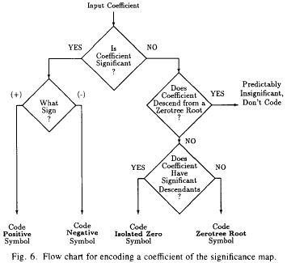
Zerotree Coding (3-3)
Encoding

Slide 11
SAQ (3-1)
Successive-Approximation Quantization (SAQ)
  Sequentially applies a sequence of thresholds T₀,···,T_{N-1} to determine significance
Thresholds
  Chose so that T_{i} = T_{i-1} /2
  T₀ is chosen so that |x_{j}| < 2T₀ for all coefficients x_{j}
Two separate lists of wavelet coefficients
  Dominant list
  Subordinate list
Dominant list contains:
The coordinates of those coefficients that have not yet been found to be significant in the same relative order as the initial scan.
Subordinate list contains:
The magnitudes of those coefficients that have been found to be significant.

Slide 12
SAQ (3-2)
Dominant pass
Subordinate pass
During a dominant pass:
coefficients with coordinates on the dominant list are compared to the threshold T_{i} to determine their significance, and if significant, their sign.
Encoding process
During a subordinate pass:
all coefficients on the subordinate list are scanned and the specifications of the magnitudes available to the decoder are refined to an additional bit of precision.
SAQ encoding process:
FOR I = T₀ TO T_{N-1}
Dominant Pass;
Subordinate Pass (generating string of symbols) ;
String of symbols is entropy encoded;
Sorting (subordinate list in decreasing magnitude);
IF (Target stopping condition = TRUE) break;
NEXT;

Slide 13
SAQ (3-3)
Decoding
  Each decode symbol, during both passes, refines and reduces the width of the uncertainty interval in which the true value of the coefficient ( or coefficients, in the case of a zerotree root)
Reconstruction value
  Can be anywhere in that uncertainty interval
  Practically, use the center of the uncertainty interval
Good feature
  Terminating the decoding of an embedded bit stream at a specific point in the bit stream produces exactly the same image that would have resulted had that point been the initial target rate

Slide 14
Adaptive Arithmetic Coding
Based on [3], encoder is separate from the model
  which is basically a histogram
During the dominant passes
  Choose one of four histograms depending on
    Whether the previous coefficient in the scan is known to be significant
    Whether the parent is known to be significant
During the subordinate passes
  A single histogram is used

Slide 15
Relationship to Other Coding Algorithms
Relationship to Bit Plane Encoding (more general & complex)
(all thresholds are powers of two and all coefficients are integers)
  Most-significant binary digit (MSBD)
    Its sign and bit position are measured and encoded during the dominant pass
  Dominant bits (digits to the left and including the MSBD)
    Measured and encoded during the dominant pass
  Subordinate bits (digits to the right of the MSBD)
    Measured and encoded during the subordinate pass
a) Reduce the width of the largest uncertainty interval in all coefficeints
b) Increase the precision further
c) Attempt to predict insignificance from low frequency to high
Item PPC EZW
1) First b) second a) First a) second b)
2) No c) c)
3) Training needed No training needed
Relationship to Priority-Position Coding (PPC)

Slide 16
Agenda
Overview
Discrete Wavelet Transform
Zerotree Coding of Wavelet Coefficients
Successive-Approximation Quantization (SAQ)
Adaptive Arithmetic Coding
Relationship to Other Coding Algorithms
A Simple Example
Experimental Results
Conclusion
References
Q & A

Slide 17
A Simple Example (2-1)
Only string of symbols shown (No adaptive arithmetic coding)
Simple 3-scale wavelet transform of an 8 X 8 image
T₀ = 32 (largest coefficient is 63)
63 -34
49 10
7 13
-12 7
-31 23
14 -13
3 4
6 -1
15 14
3 -12
5 -7
3 9
-9 -7
-14 8
4 -2
3 2
-5 9
-1 47
4 6
-2 2
3 0
-3 2
3 -2
0 4
2 -3
6 4
3 6
3 6
5 11
5 6
0 3
-4 4
Example

Slide 18
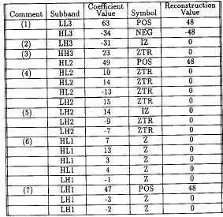

A Simple Example (2-2)
First dominant pass
First subordinate pass
63 -34
49 10
7 13
-12 7
-31 23
14 -13
3 4
6 -1
15 14
3 -12
5 -7
3 9
-9 -7
-14 8
4 -2
3 2
-5 9
-1 47
4 6
-2 2
3 0
-3 2
3 -2
0 4
2 -3
6 4
3 6
3 6
Magnitudes are partitioned into the uncertainty intervals [32, 48) and [48, 64), with symbols “0” and “1”.
5 11
5 6
0 3
-4 4
Example

Slide 19
Experimental Results
12-byte header
  Number of wavelet scales
  Dimensions of the image
  Maximum histogram count for the models in the arithmetic coder
  Image mean & initial threshold
Applied to standard b/w 8 bpp. test images
  512 X 512 “Lena” image
  512 X 512 “Barbara” image
For image of “Barbara”:
Item JPEG EZW
Same file size PSNR lower Looks better
Same PSNR Looks better File size smaller
( PSNR: Peak-Signal-to-Noise-Rate )
For number of significant coefficients retained at the same low bit rate:
Item Other EZW
Number retained Less More
(Reason: The zerotree coding provides a much better way of encoding the positions of the significant coefficients.)
Compared with JPEG
Compared with other wavelet transform coding

Slide 20
Conclusion
2 Properties
  Producing a fully embedded bit stream
  Providing competitive compression performance
4 Features
  Discrete wavelet transform
  Zerotree coding of wavelet coefficients
  Successive-approximation quantization (SAQ)
  Adaptive arithmetic coding
2 Advantages
  Precise rate control
  No training of any kind required

Slide 21
References
1. E. H. Adelson, E. Simoncelli, and R. Hingorani, “Orthogonal pyramid transforms for image coding,” Proc. SPIE, vol.845, Cambridge, MA, Oct. 1987, pp. 50-58
2. S. Mallat, “A theory for multiresolution signal decomposition: The wavelet representation,” IEEE Trans. Pattern Anal. Mach. Intell., vol. 11, pp. 674-693, July 1989
3. I. H. Witten, R. Neal, and J. G. Cleary, “Arithmetic coding for data compression,” Comm. ACM, vol. 30, pp. 520-540, June 1987
4. J. Shapiro, “Embedded image coding using zerotrees of wavelet coefficients,” IEEE Trans. Signal Processing., vol. 41, pp. 3445-3462, Dec. 1993

Slide 22
Thank You!
QUESTION ?

